Slide 1

BREAKING BARRIERS IN SOFT TISSUE RESEARH: COLLABORATIVE INSIGHTS AND FUTURE DIRECTIONS
Poromechanics to Investigate the Impact of Mechanical Loading on Human Skin Micro-Circulation
T. Lavigne^{1,2,3}, S. Urcun¹, B. Fromy^{4,5}, A. Josset-Lamaugarny^{4,5}, A. Lagache^{2,3}, C. A. Suarez-Afanador¹, S. P. A. Bordas¹, P-Y. Rohan², G. Sciumè^{3,6}
1. University of Luxembourg, Esch-sur-Alzette, Luxembourg; 2. Arts et Métiers Institute of Technology, Paris, France; 3. University of Bordeaux, Talence, France; 4. LBTI, Lyon, France; 5. Claude Bernard University Lyon, Villeurbanne, France; 6. Institut Universitaire de France (IUF), France
AFR-FNR 17013812

Slide 2

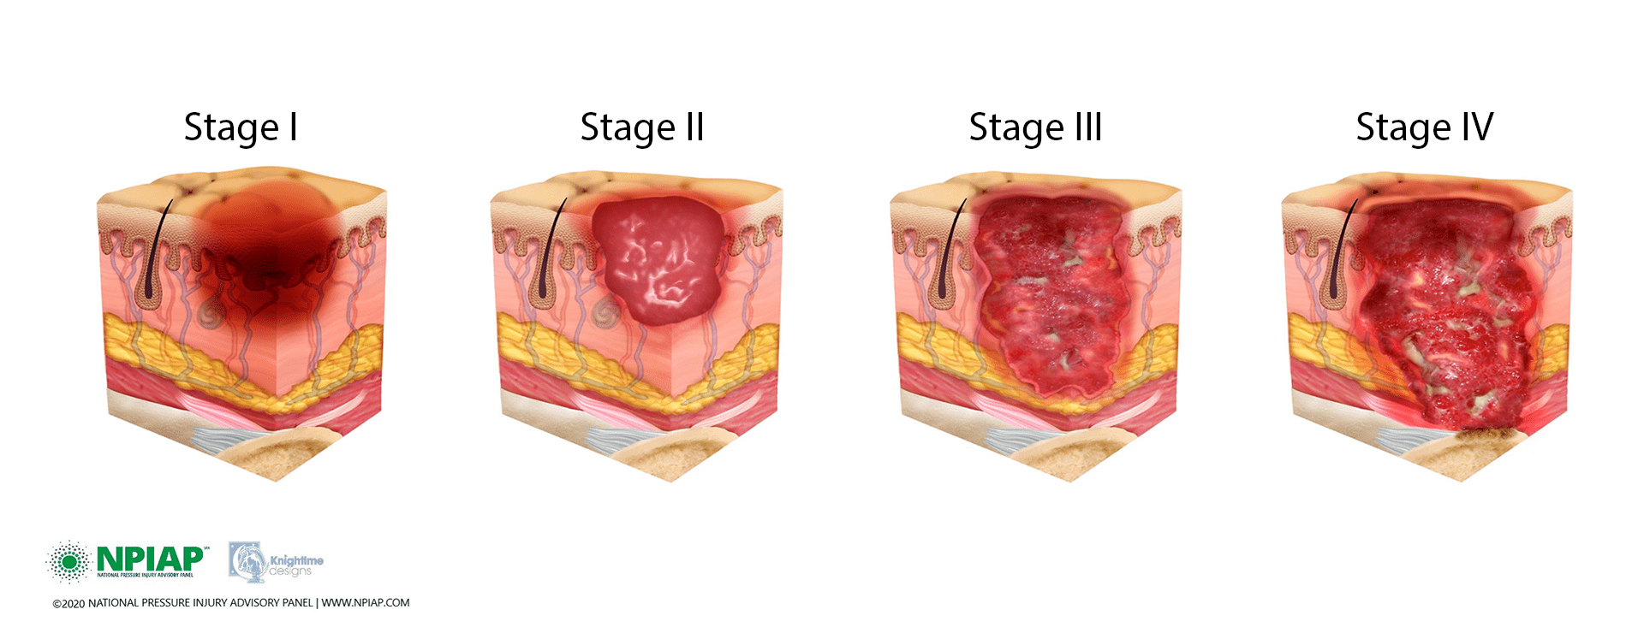












Still millions of pressure ulcers
[Vanderwee et al., 2007]
[Ayello 2008; Parvizi et al. 2023]

Slide 3

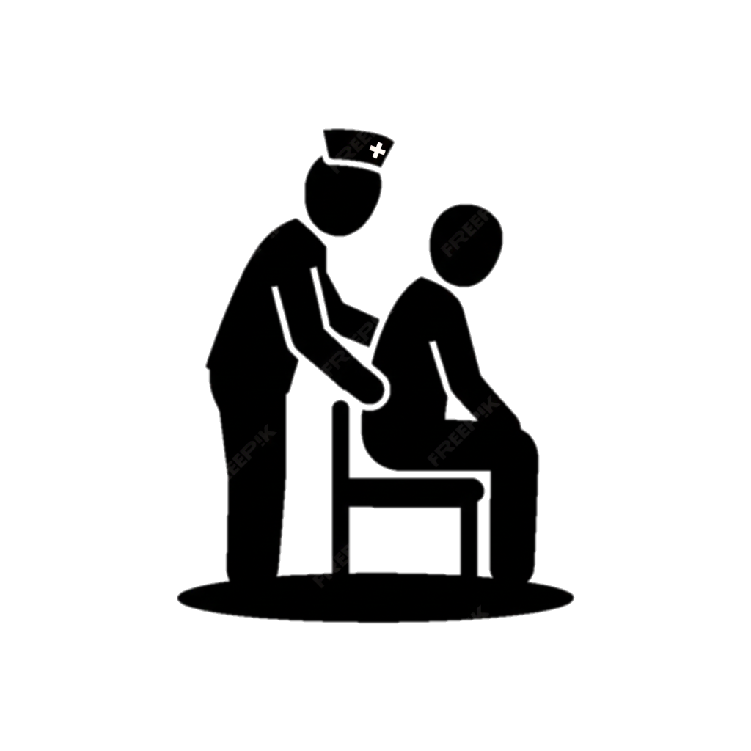
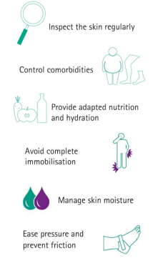

Clinical reality
Norton score

Slide 4
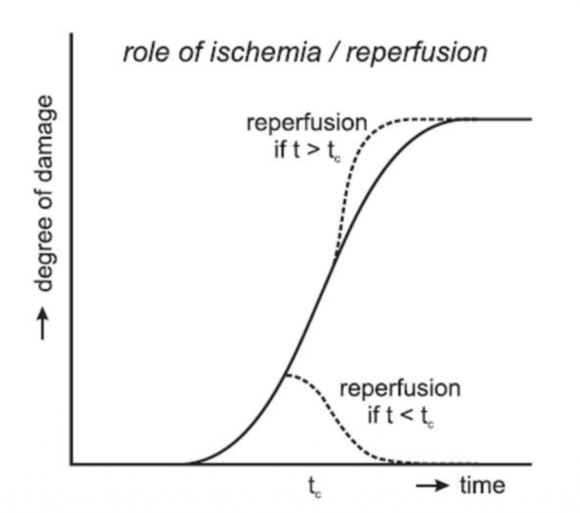
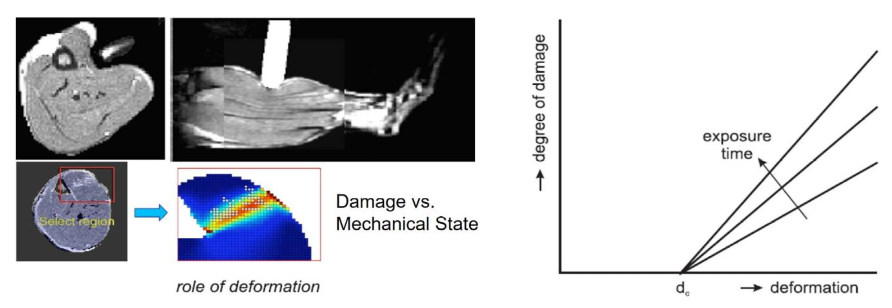
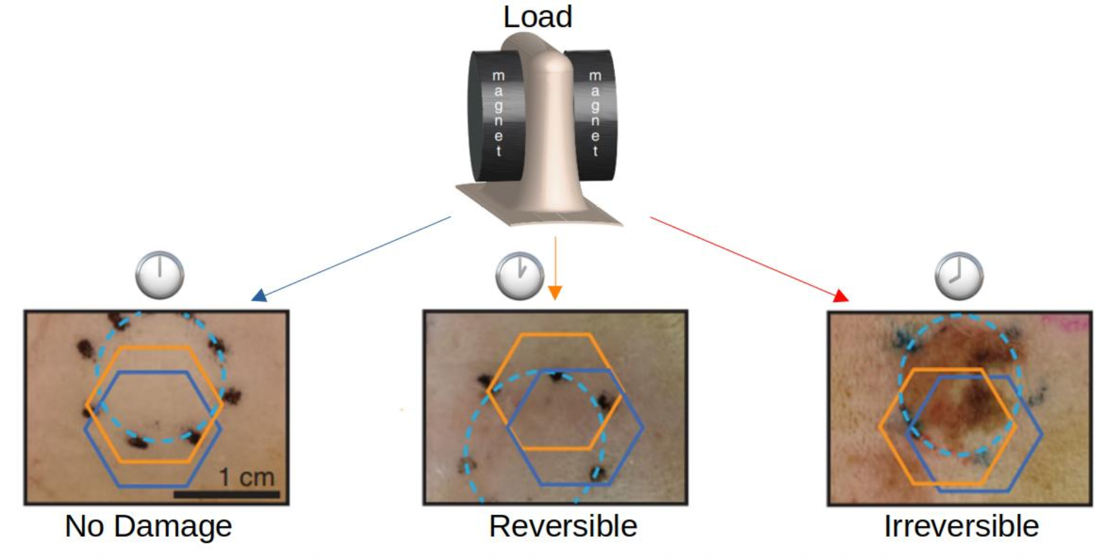
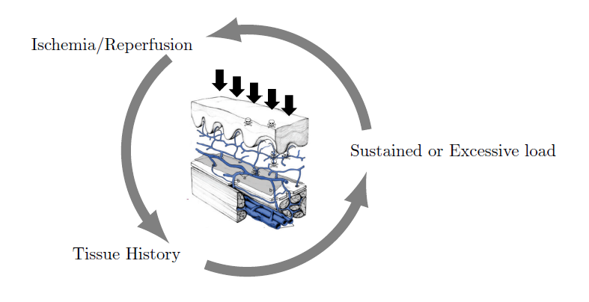
Animal & Clinical research
Oxygen deprivation
[Coleman et al., 2014, Loerakker et al., 2011]
External forces
[Coleman et al., 2014, Ceelen et al., 2008, Loerakker et al., 2011]
State of the tissue
[Coleman et al., 2014, Swisher et al., 2015]

Slide 5

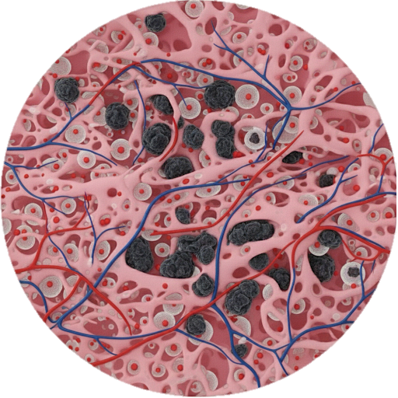

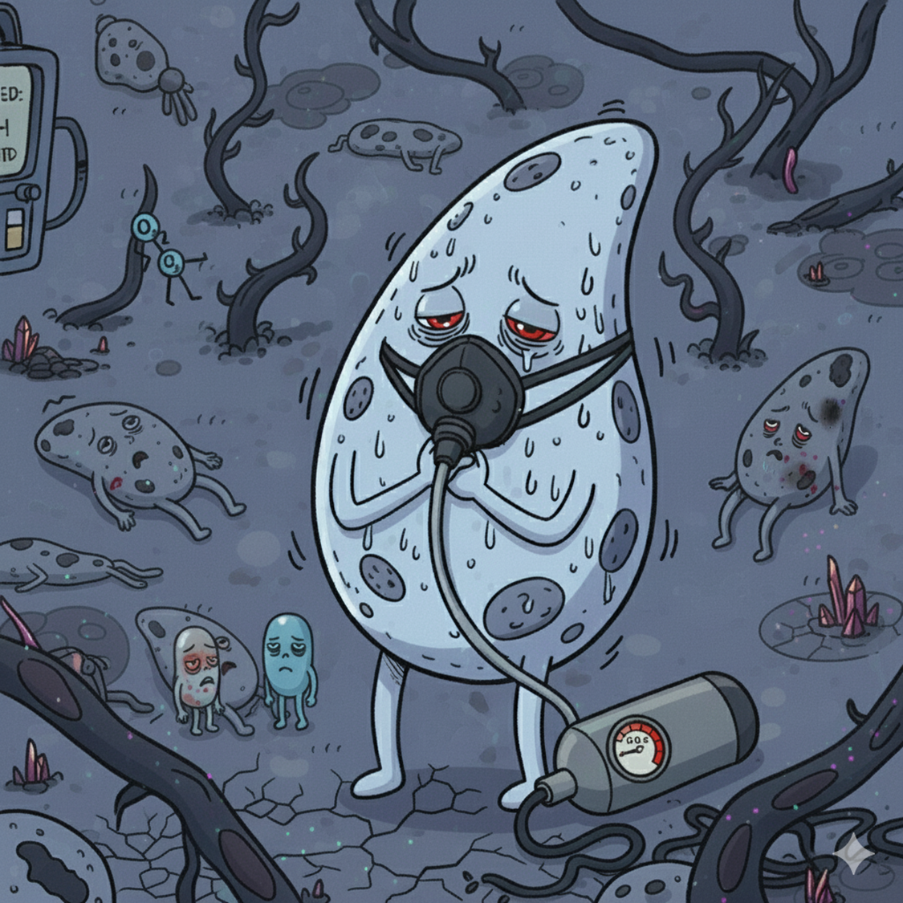

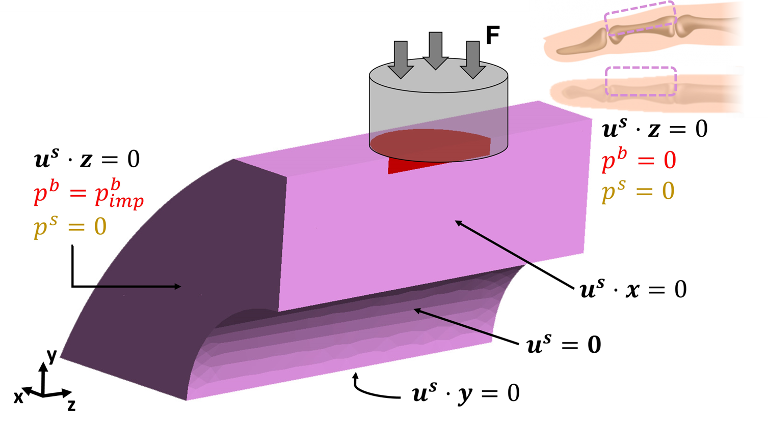
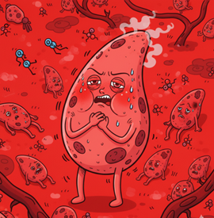

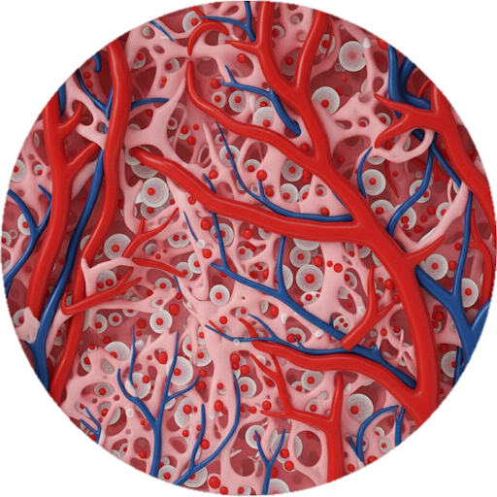
Interplay?
Oxygen deprivation
External forces
State of the tissue

Slide 6

Coupling Biology and Mechanics
Oxygen deprivation
External forces
State of the tissue

Slide 7
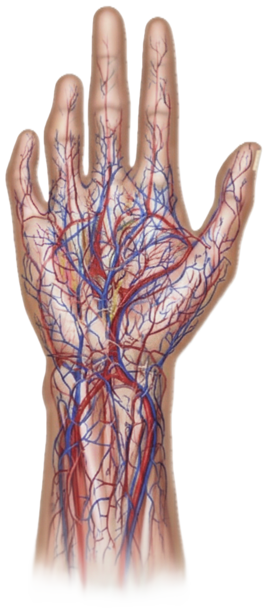
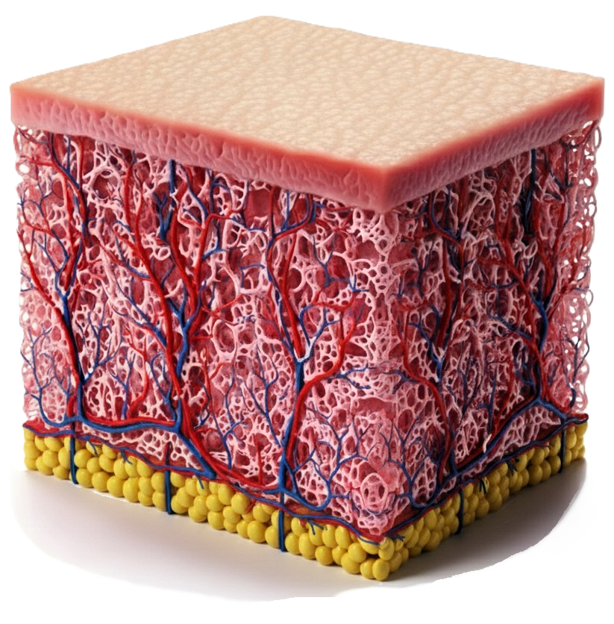
The Human skin as a sponge
Macroscale
Stratified
Fibrous
60% of water
[Burns et al., 2010]
Some images are AI generated

Slide 8
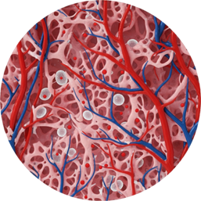
The Human skin as a sponge
Microscale
Interstitial fluid
Mobile cells
Structural cells and other structures
Connective tissue
Micro-vascular system = oxygen supply
Some images are AI generated

Slide 9
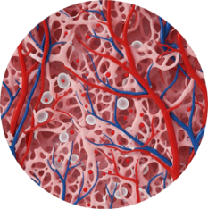
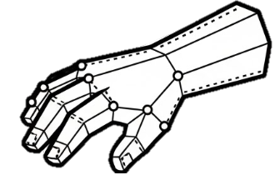
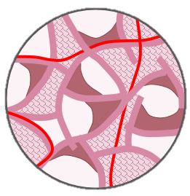


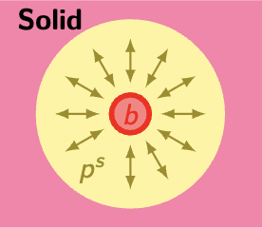


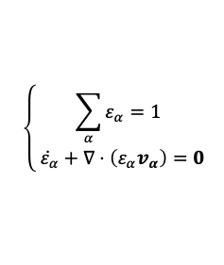
The Porous (bricks) Model
Conservation Laws
Constitutive Laws
Mass Conservation
Solid
Solid
Cells
Oxygen
Stress-Strain law
How does it work?
Increasing force on the solid
Increased pressure in the pores
Squeezed blood vessels
IF
$$\left\{\begin{aligned}\sum_{α}{ε_{α}}=1 \\ \dot{{ ε}_{α}}+∇⋅\left(ε_{α}v_{α}\right)=0\end{aligned}\right.$$
Pores
F(u, p^{α}) =
Blood
IF pressure / Cell Saturation
Force Equilibrium
Vascular phase
Porosity
Permeability
Total stress
Darcy Blood
Oxygen
Darcy IF
Darcy Cells
$$∇⋅σ_{tot}=0$$
Diff. Oxygen
Abs. Oxygen
[Lavigne et al. 2023, 2025a, 2025b , 2025c]
Adapted from the TCAT, [Gray and Miller, 2014]

Slide 10
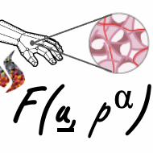
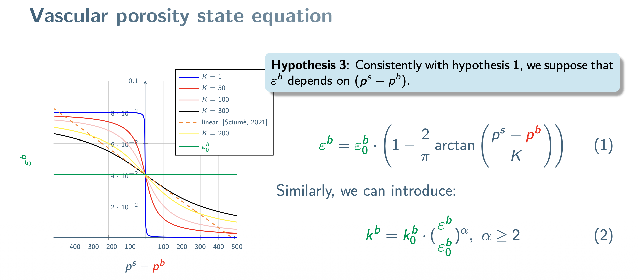
Vascular porosity state equation

Slide 11
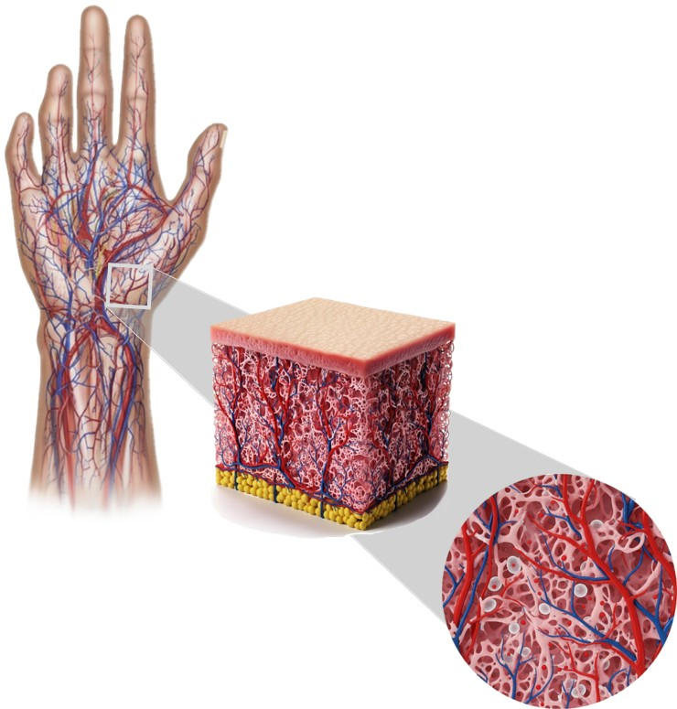
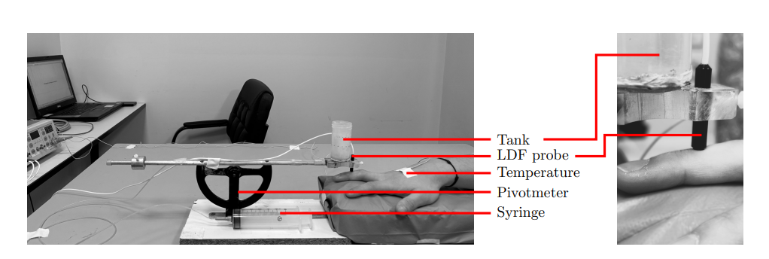
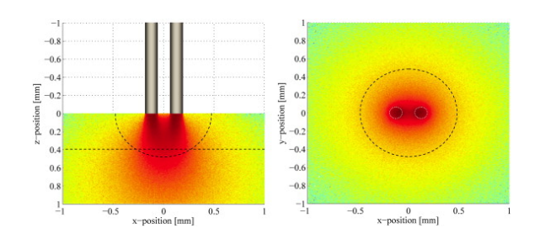
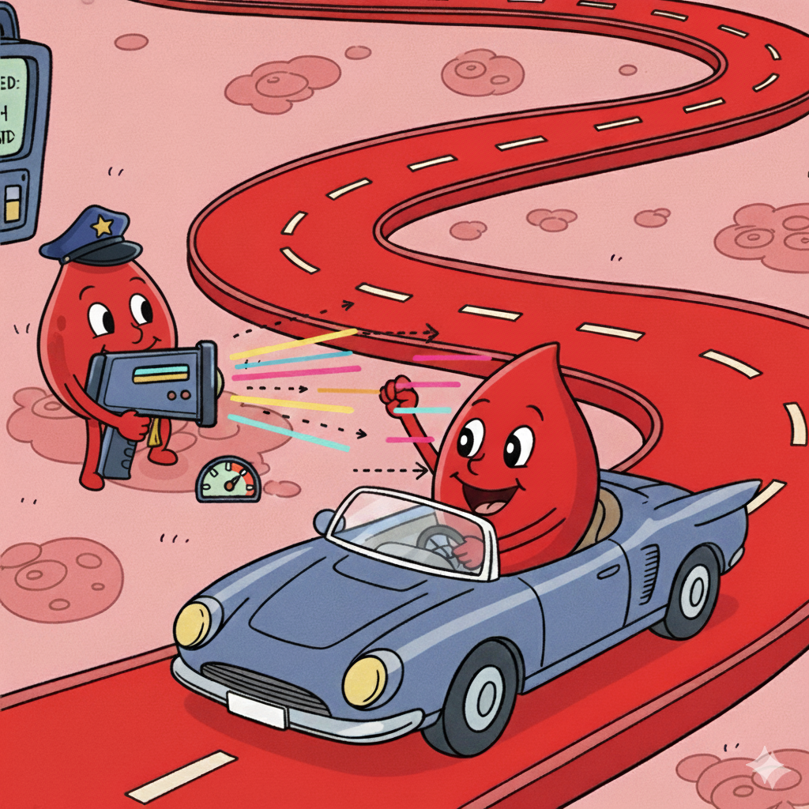
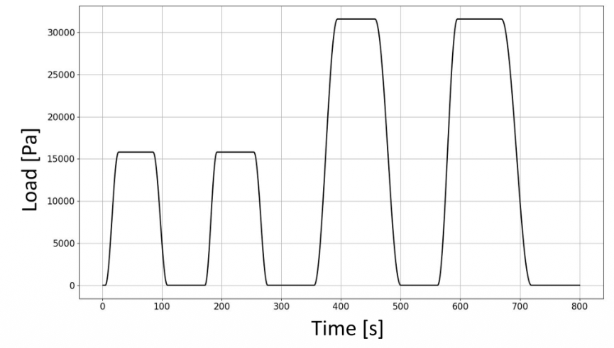


Experimental setup
Ethical approval N°2023-A00418-37
[Fredriksson et al., 2009]
$$25±2 yo$$
N= 6
N= 5
Some images are AI generated

Slide 12
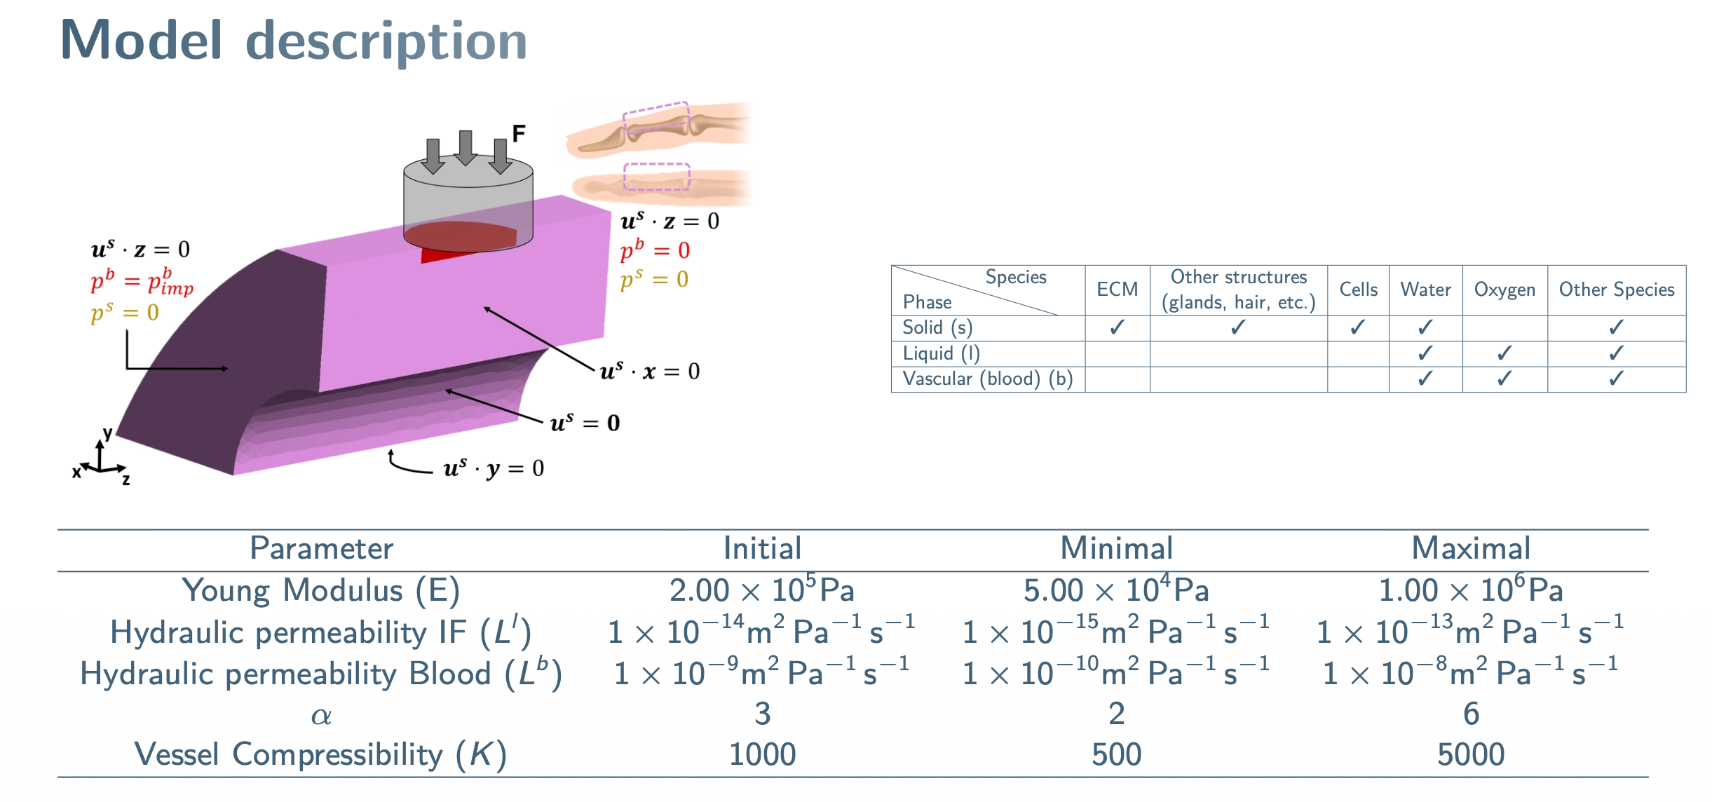
Model description

Slide 13
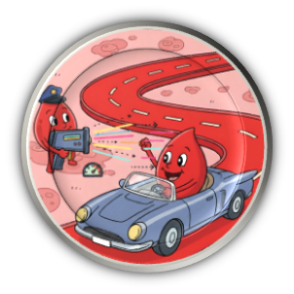
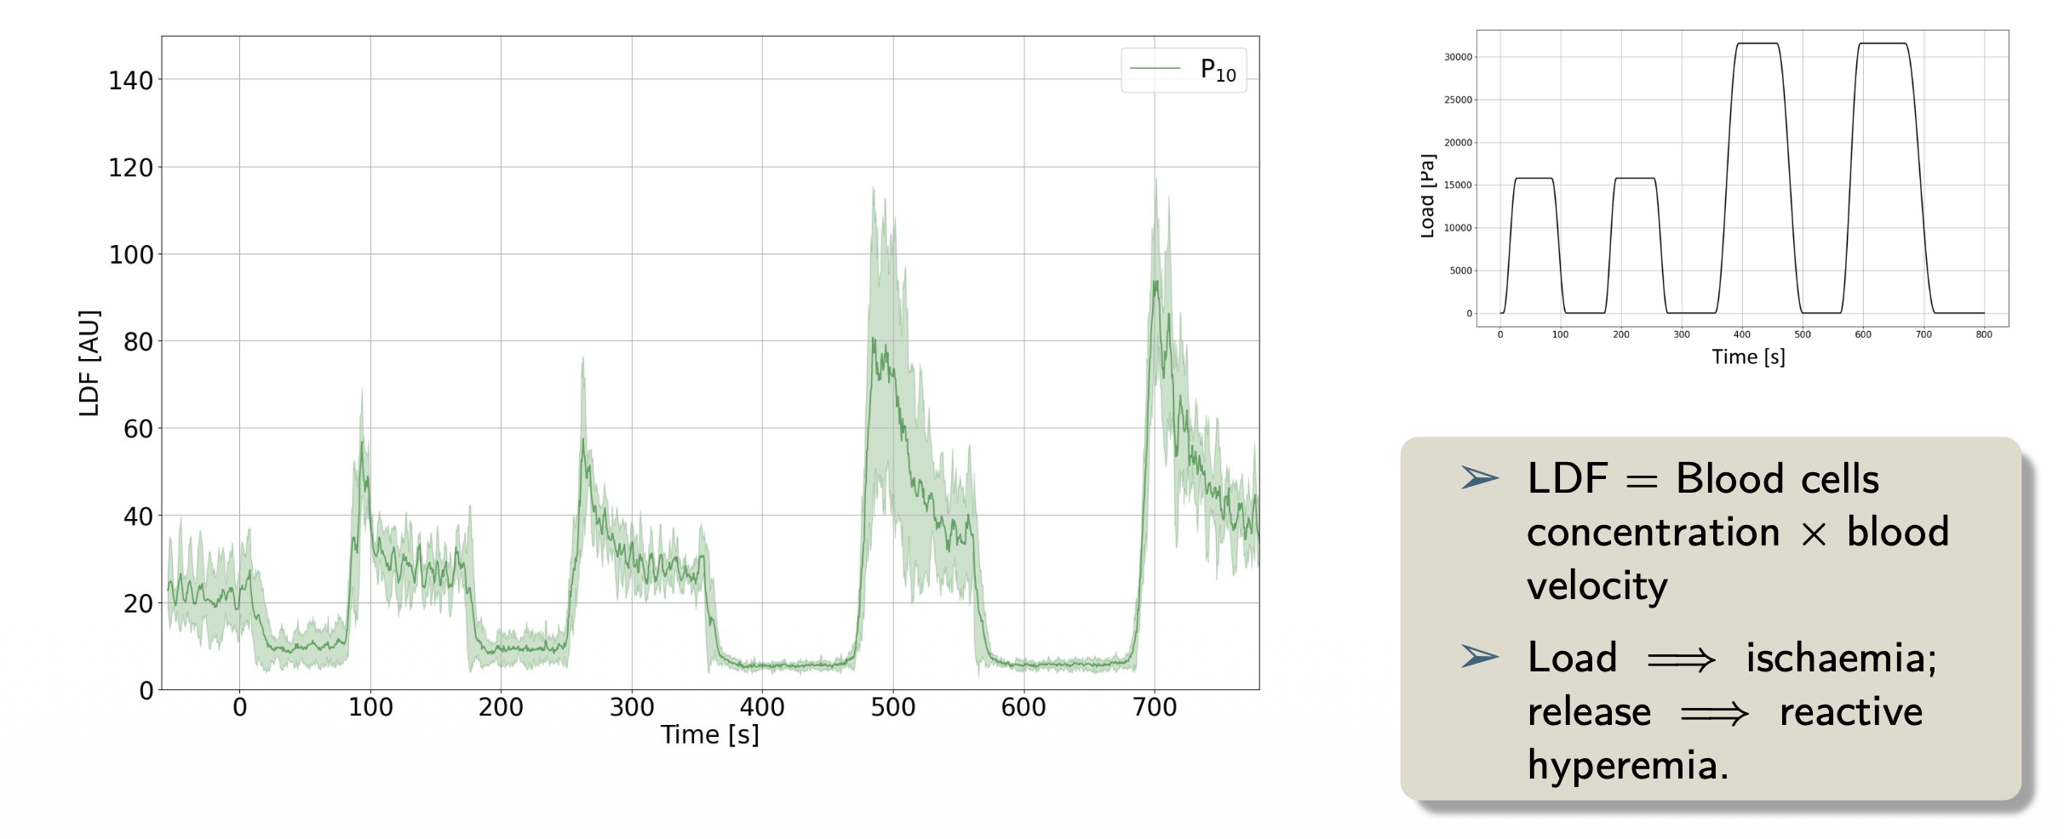
Raw LDF signal

Slide 14
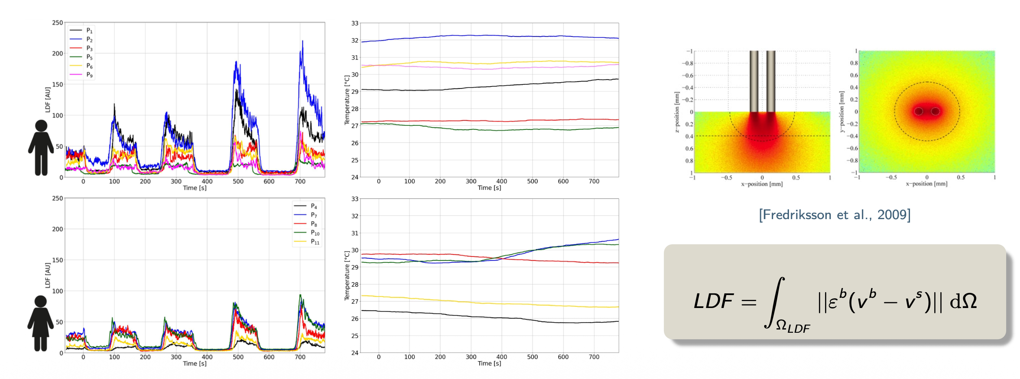
Raw LDF signals

Slide 15
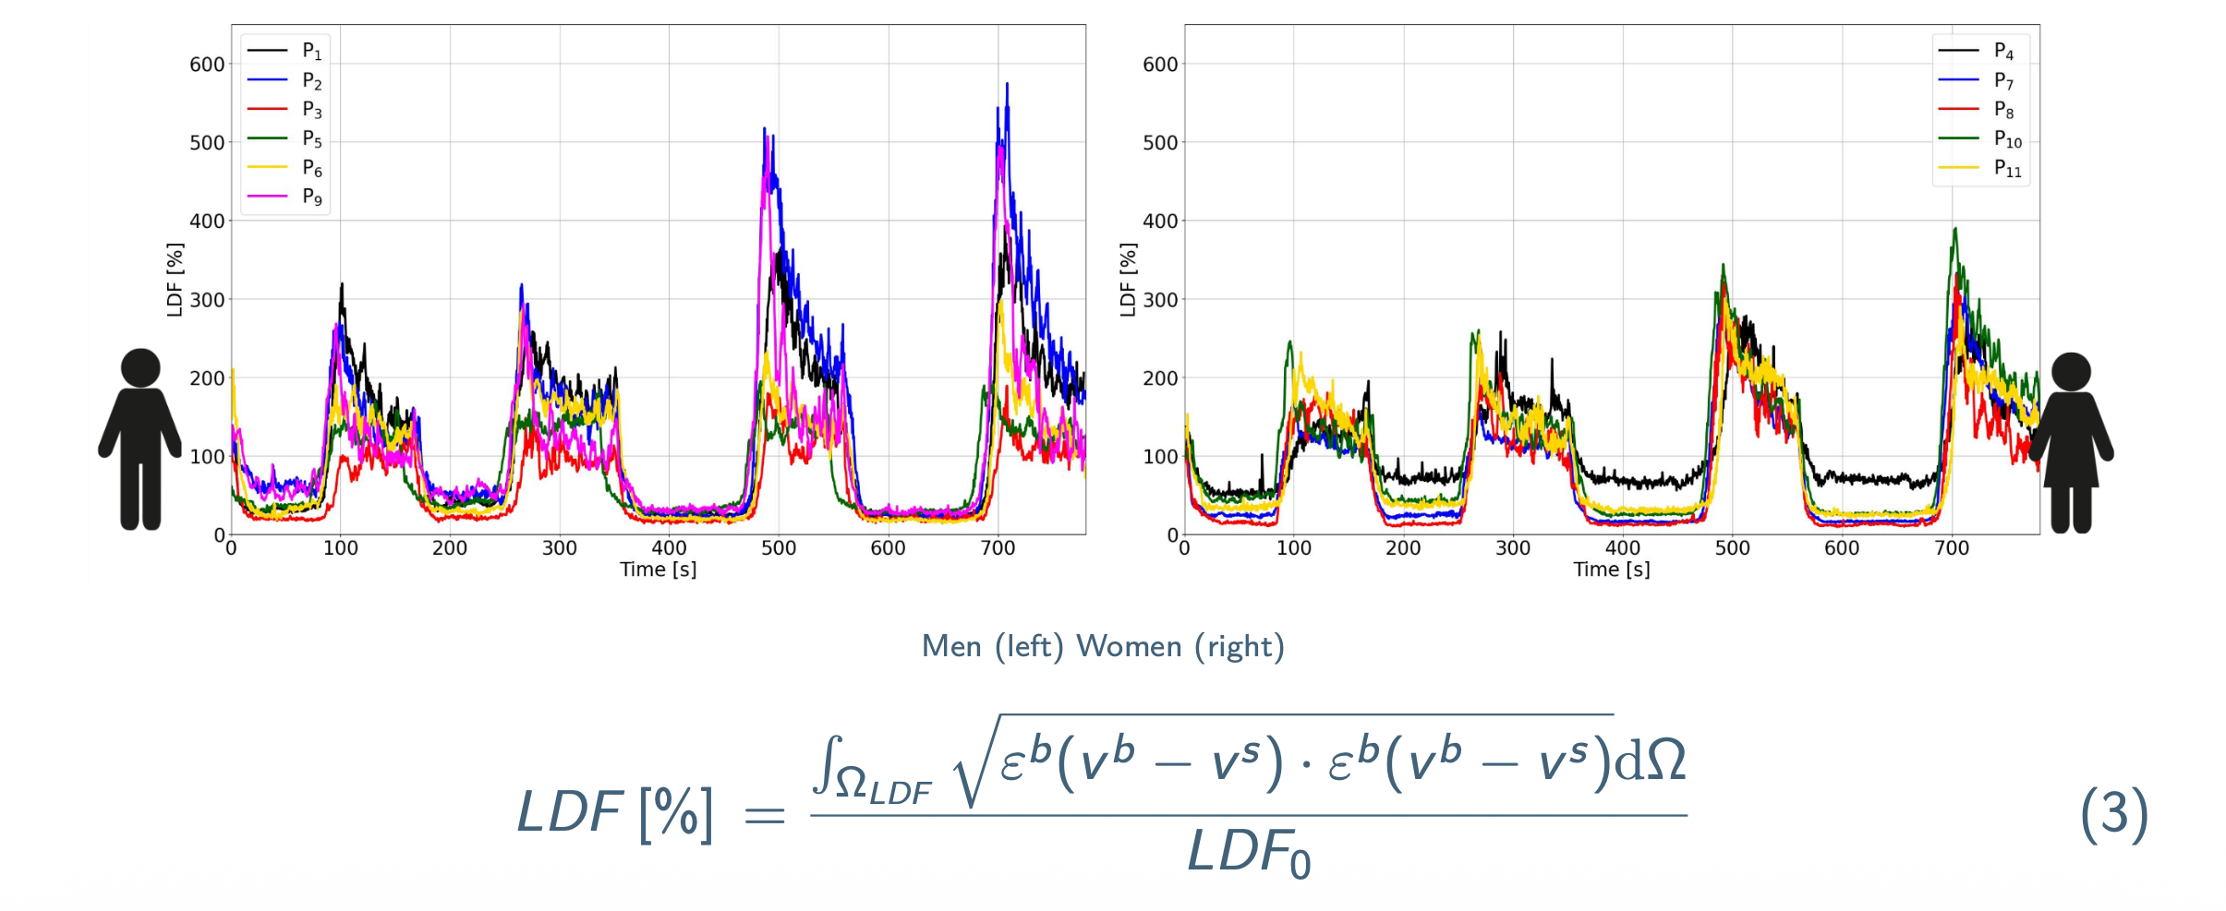
Relative LDF signal

Slide 16
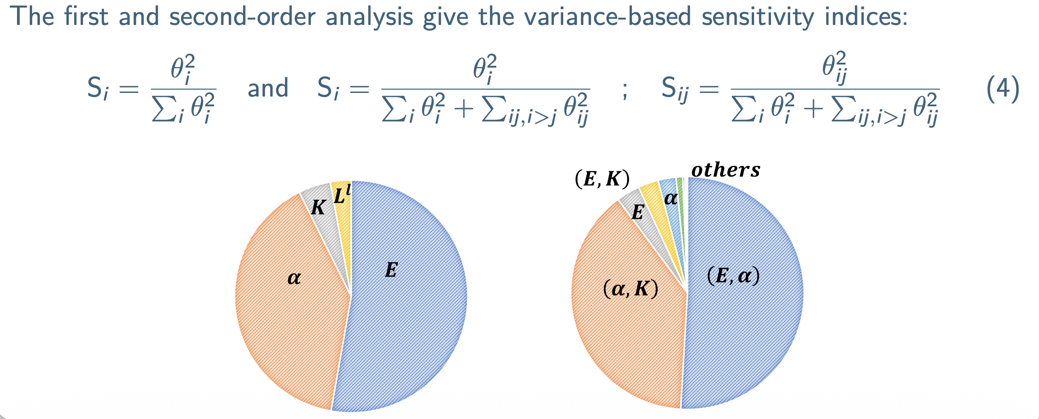
Variance-based sensitivity analysis

Slide 17
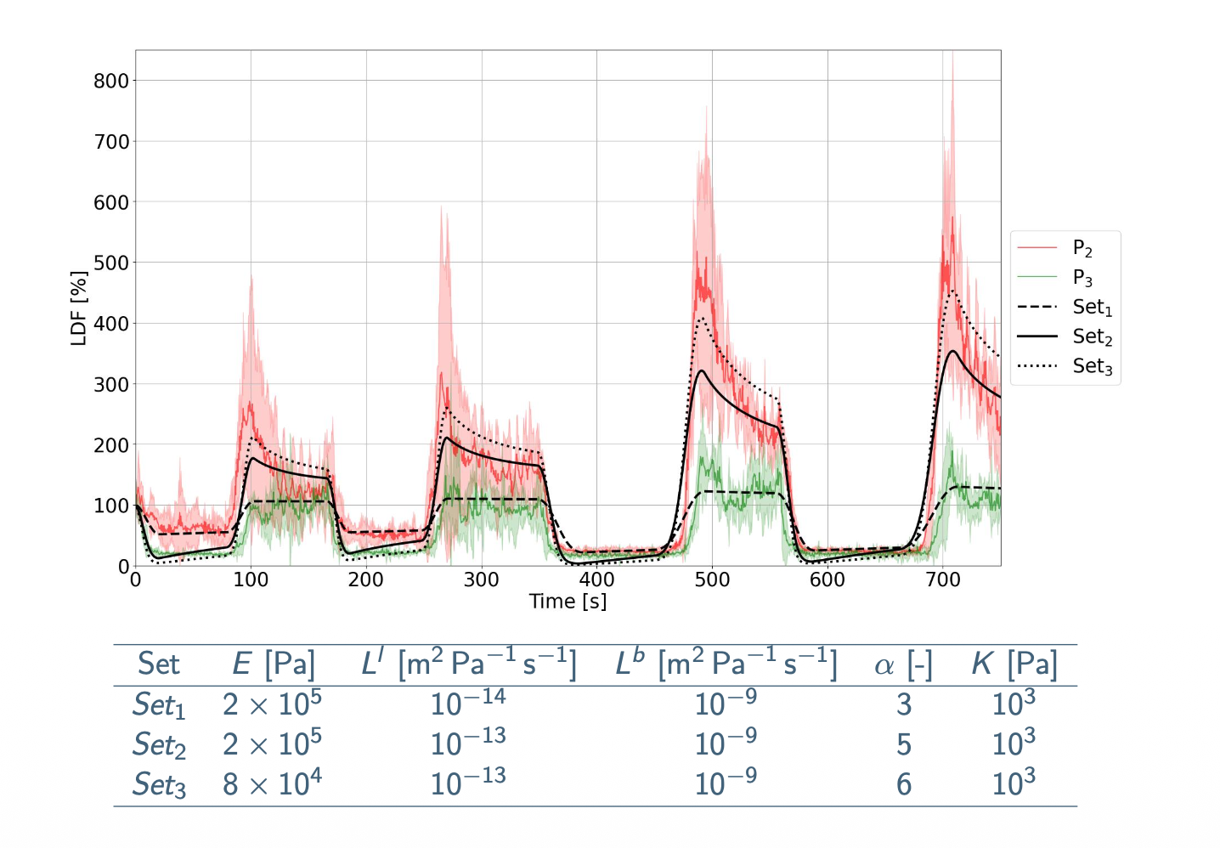
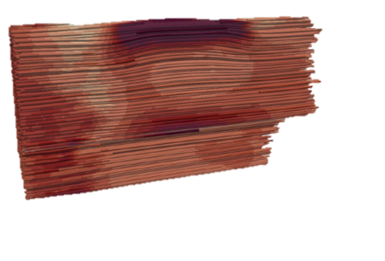
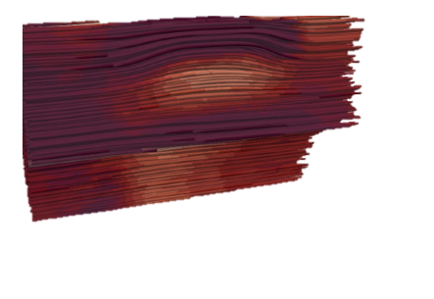
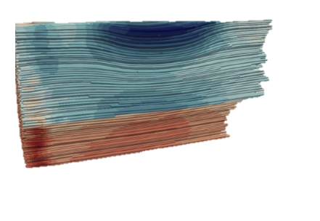
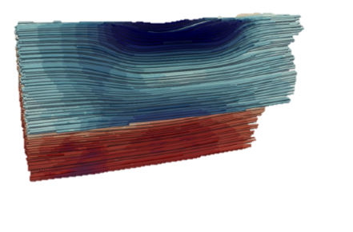
Model vs Patient data
Ischaemia (Hypoxia)
Hyperemia (Oxydation – Water-hammer pulse)
Some images are AI generated

Slide 18



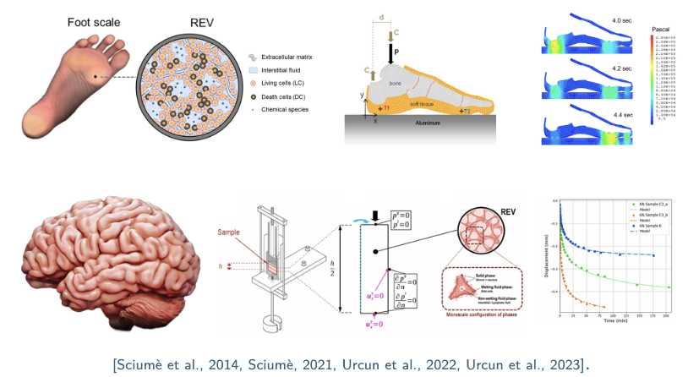
Perspectives
Towards Personnalized Treatment
✔ Relative Ischaemia and PORH are comparable between genders,
✔ Mechanics play a role in PORH,
✔ Model capacity to reproduce ischaemia and PORH,
✔ Allows for a future introduction of biological exchanges,
~ More accurate control of the multiscale BCs,
~ No clear consensus on material parameters,
~ Future work should assess subject-specific calibration.
Highly modular approach
Some images are AI generated
✔ Hierarchical and Modular porous framework,
✔ Ischaemia and PORH were obtained with mechanics only,
✔ Open-source implementation,
✔ Transferable: plantar foot, brain, tissue engineering, drug delivery, ➪ Biological integration should be compared to experimental campaigns,
➪ For pressure ulcers prevention, damage and remodelling should be introduced,

Slide 20

Ayello, C. H. L. E. A. (2008). “Patient Safety and Quality: An Evidence-Based Handbook for Nurses.” In: NIH. Chap. 12.
Ceelen, K., Stekelenburg, A., Loerakker, S., Strijkers, G., Bader, D., Nicolay, K., Baaijens, F., and Oomens, C. (2008). “Compression-induced damage and internal tissue strains are related.” Journal of Biomechanics, 41(16):3399–3404.
Coleman, S., Nixon, J., Keen, J., Wilson, L., McGinnis, E., Dealey, C., Stubbs, N., Farrin, A., Dowding, D., Schols, J. M., Cuddigan, J., Berlowitz, D., Jude, E., Vowden, P., Schoonhoven, L., Bader, D. L., Gefen, A., Oomens, C. W., and Nelson, E. A. (2014). “A new pressure ulcer conceptual framework.” Journal of Advanced Nursing, 70(10):2222–2234.
Fredriksson, I., M. Larsson, and T. Strömberg (2009). “Measurement depth and volume in laser Doppler flowmetry”. In: Microvascular Research 78.1, pp. 4–13.
Gray, W. G. and Miller, C. T. (2014). “Introduction to the Thermodynamically Constrained Averaging Theory for Porous Medium Systems.” Springer International Publishing.
Lavigne, T., S. Urcun, P.-Y. Rohan, G. Sciumè, D. Baroli, and S. P. Bordas (2023). “Single and bi-compartment poro-elastic model of perfused biological soft tissues: FEniCSx implementation and tutorial”. In: Journal of the Mechanical Behavior of Biomedical Materials 143, p. 105902
Lavigne, T., S. Urcun, E. Jacquet, J. Chambert, A. Elouneg, C. A. Suarez-Afanador, S. P. A. Bordas, G. Sciumè, and P.-Y. Rohan (2025a). Poromechanical modelling of the time-dependent response of in vivo human skin during extension. In: International Journal for Numerical Methods in Biomedical Engineering.
Lavigne, T., S. Urcun, B. Fromy, A. Josset-Lamaugarny, A. Lagache, C. A. Suarez-Afanador, S. P. A. Bordas, P.-Y. Rohan, and G. Sciumè (2025b). “Hierarchical poromechanical approach to investigate the impact of mechanical loading on human skin micro-circulation”. In: International Journal for Numerical Methods in Biomedical Engineering.
Lavigne T, Biomechanical Modeling of Human skin: a Hierarchical Porous Media Framework. PhD, Biomechanical Response of Human Skin : A Hierarchical Porous Media Framework. | Theses.fr
Loerakker, S., Manders, E., Strijkers, G. J., Nicolay, K., Baaijens, F. P. T., Bader, D. L., and Oomens, C. W. J. (2011). “The effects of deformation, ischemia, and reperfusion on the development of muscle damage during prolonged loading.” Journal of Applied Physiology, 111(4):1168–1177.
Parvizi, A., S. Haddadi, A. Mollaei, P. Ghorbani Vajargah, P. Takasi, M. Firooz, S. J. Hosseini, R. Farzan, and S. Karkhah (2023). “A systematic review of nurses’ knowledge and related factors towards the prevention of medical device-related pressure ulcers”. In: International Wound Journal 20.7, pp. 2843–2854.
Vanderwee, K., M. Clark, C. Dealey, L. Gunningberg, and T. Defloor (2007). “Pressure ulcer prevalence in Europe: a pilot study”. In: Journal of Evaluation in Clinical Practice 13.2, pp. 227–235

Slide 21

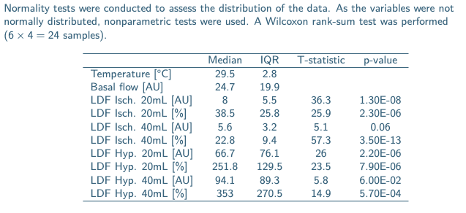
LDF Statistics and values (F)

Slide 22
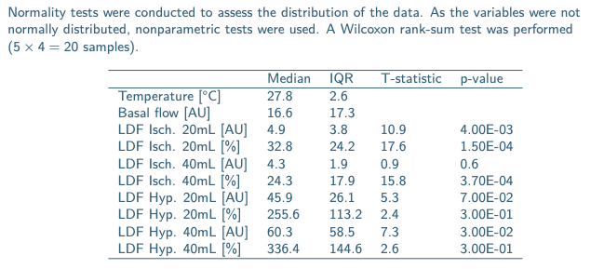
LDF Statistics and values (M)

Slide 23
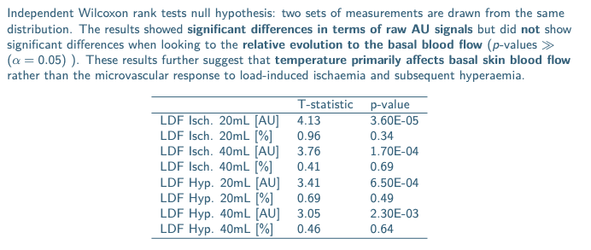
LDF Statistics and values (M - F)

Slide 24
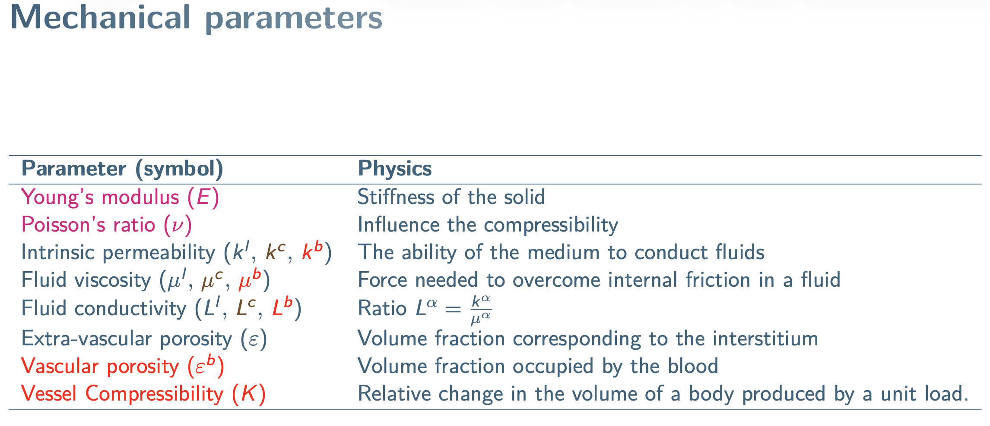

Slide 25
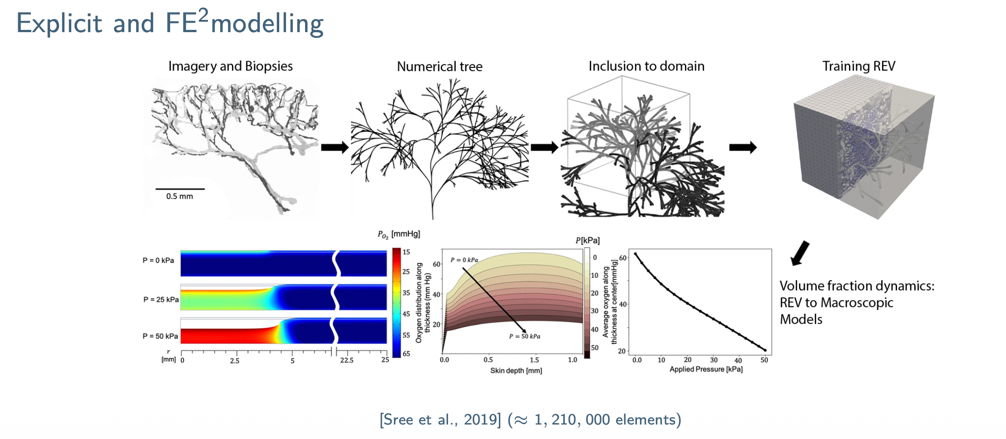

Slide 26
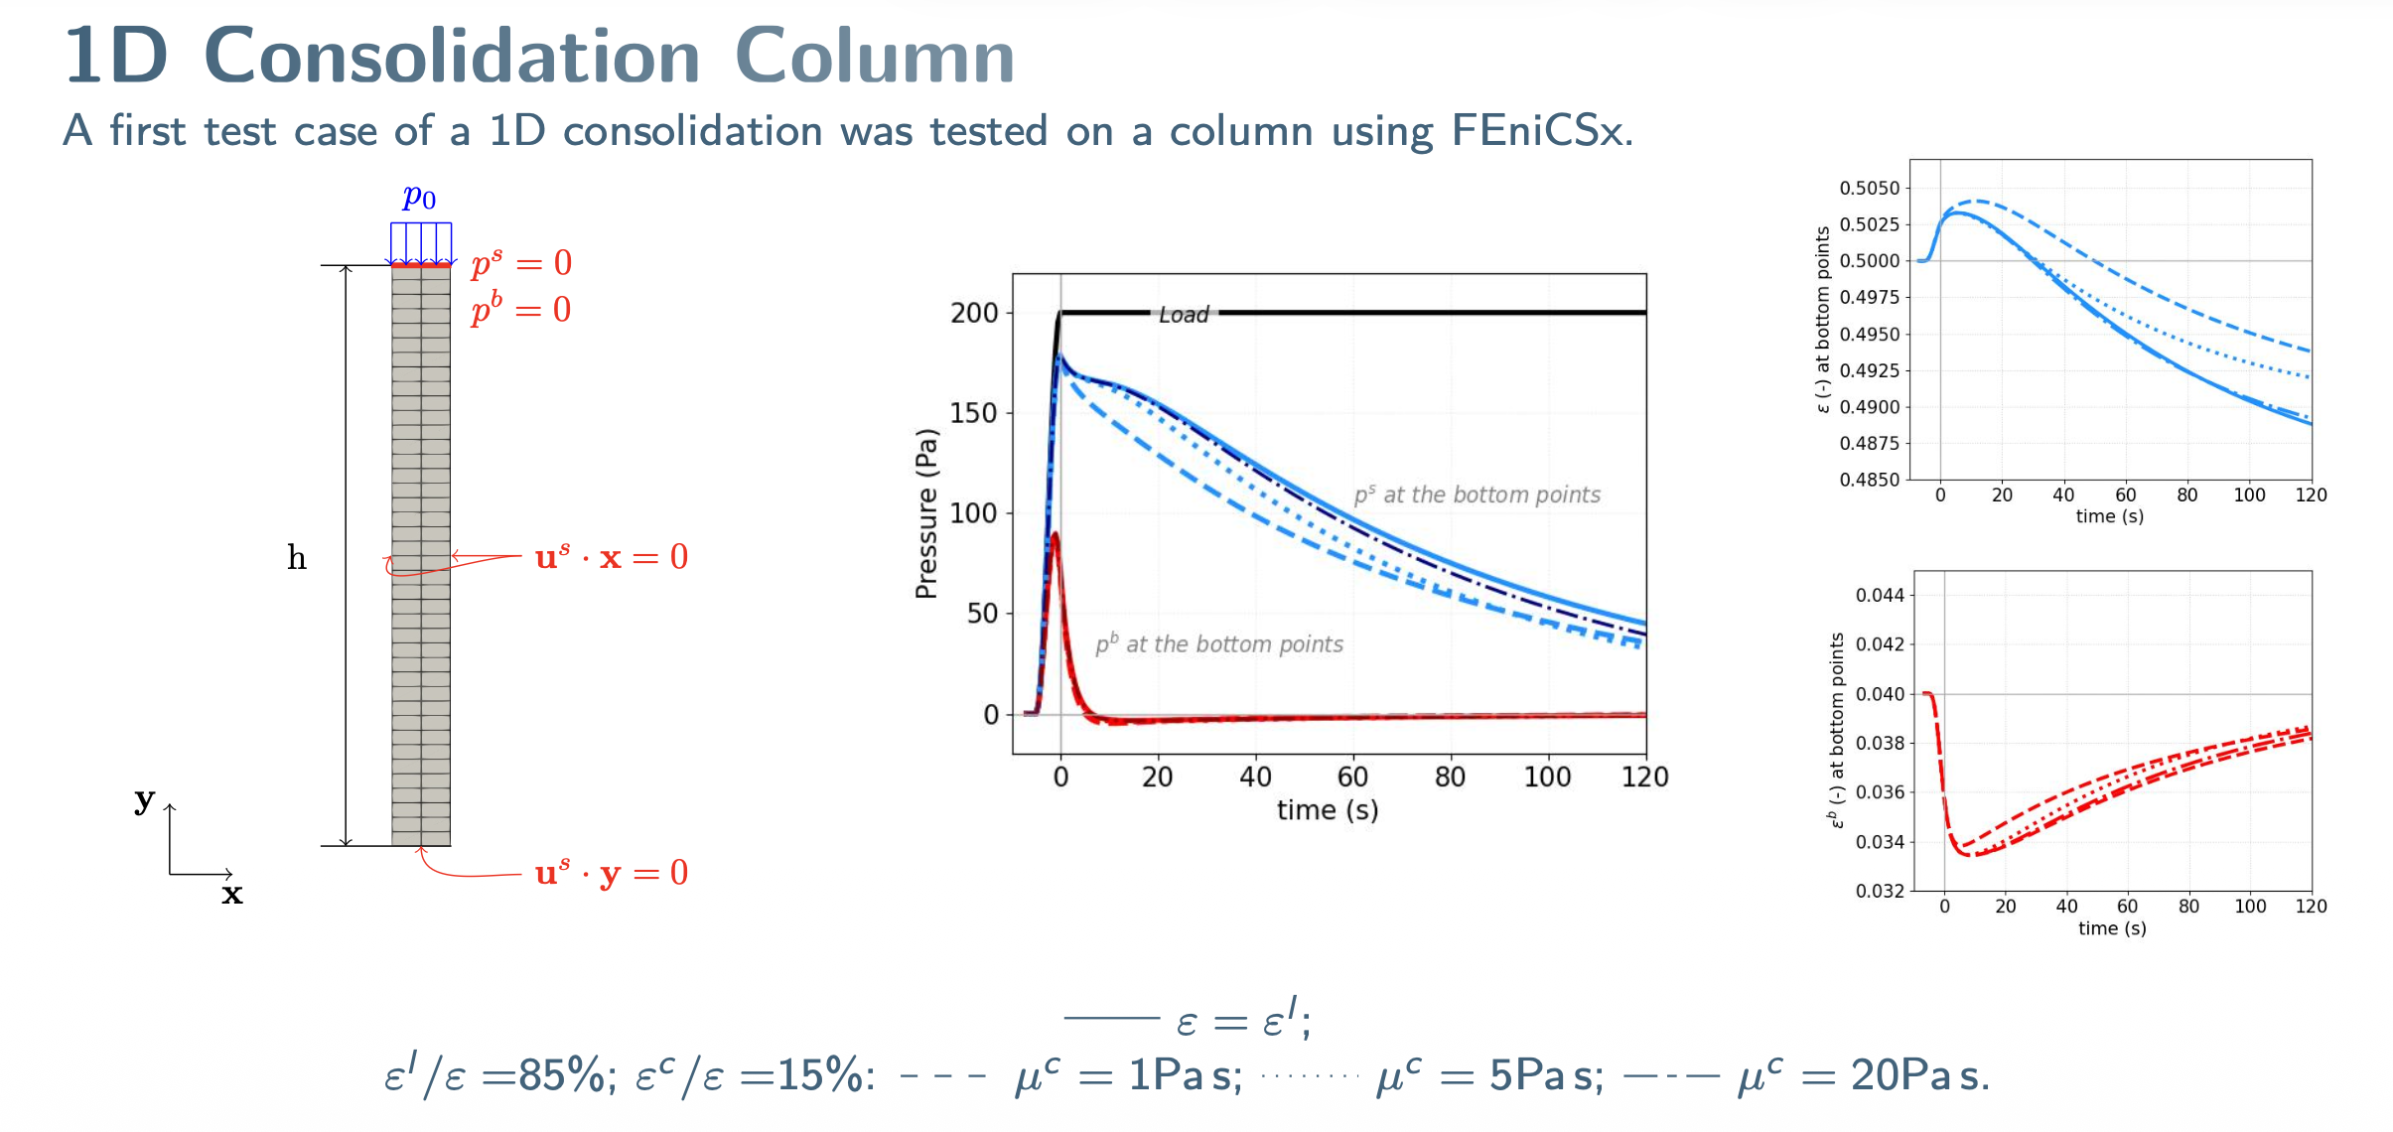

Slide 27
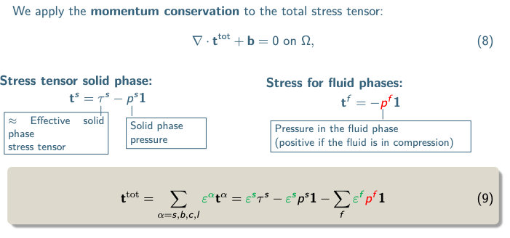
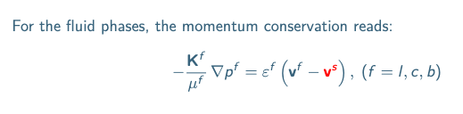
Momentum conservation

Slide 28
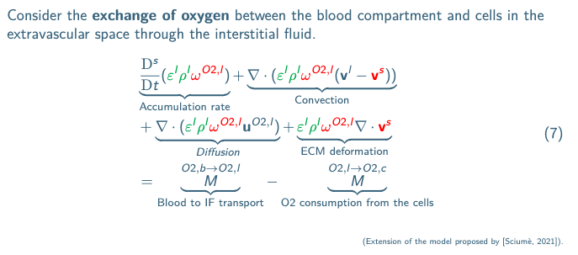
Oxygen biochemistry

Slide 29
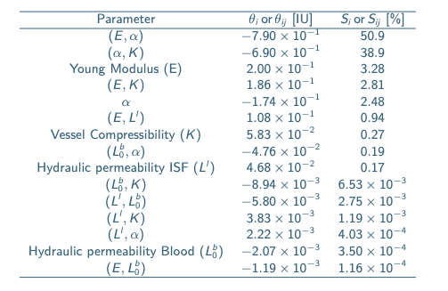
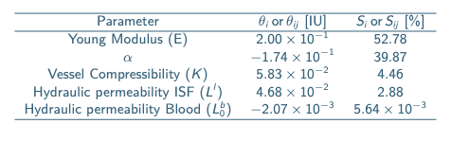
Variance-based sensitivity

Slide 30

Porous parameters table

